Slide 1
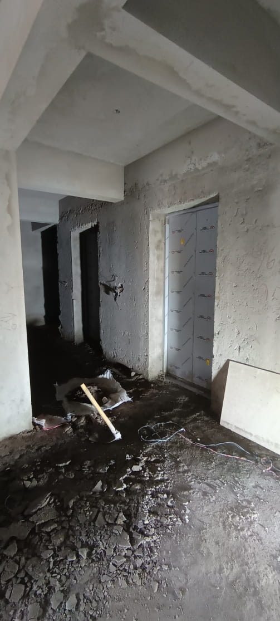
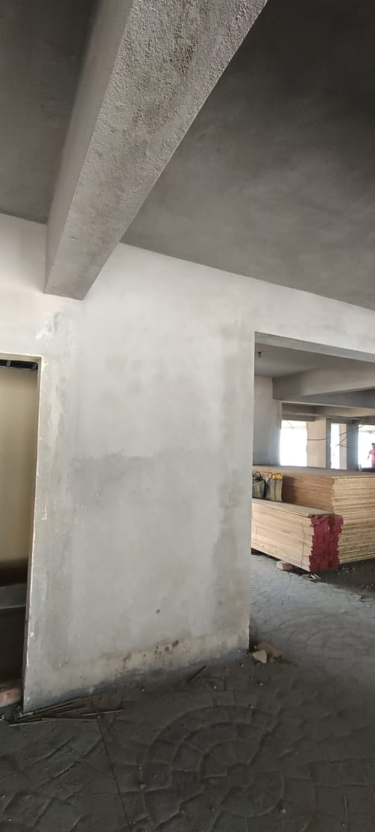
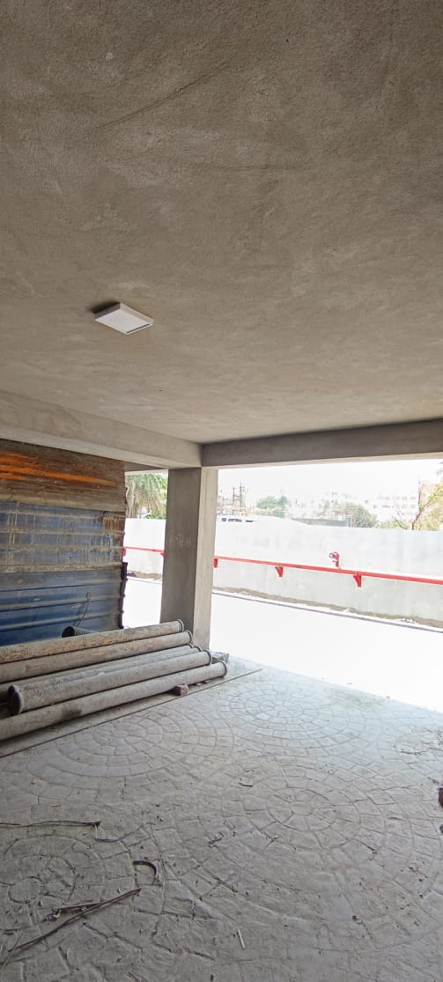
TOWER 1 - GROUND FLOOR BRICK SOLING AND PLASTERING WORK COMPLETED, FLOORING WORK IN PROGRESS

Slide 2
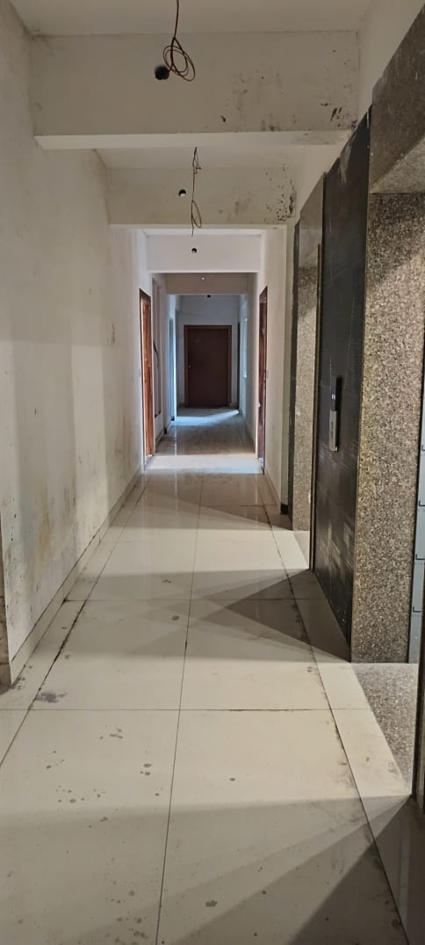
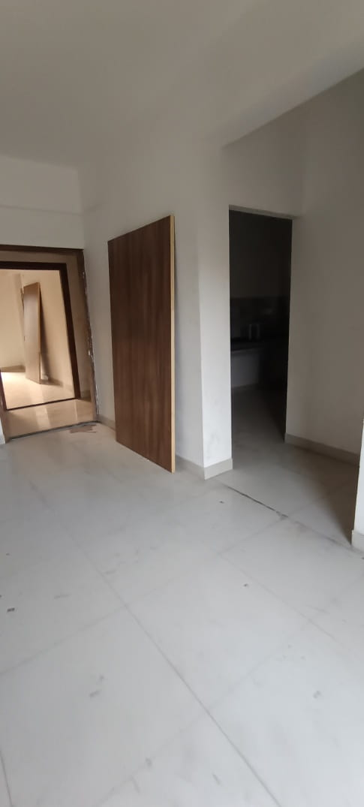
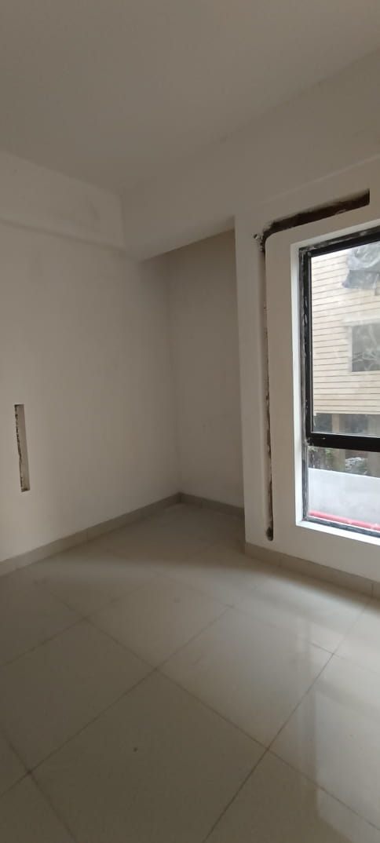
TOWER 1- 1ST FLOOR STRUCTURAL WORKS COMPLETED, FINISHES IN PROGRESS
1ST FLOOR LOBBY STRUCTURAL WORK COMPLETED
1ST FLOOR FLAT A – FLOORING, PUTTY, DOOR FRAME FIXING WORK COMPLETED
1ST FLOOR FLAT F -- FLOORING, PUTTY, DOOR FRAME FIXING WORK COMPLETED

Slide 3
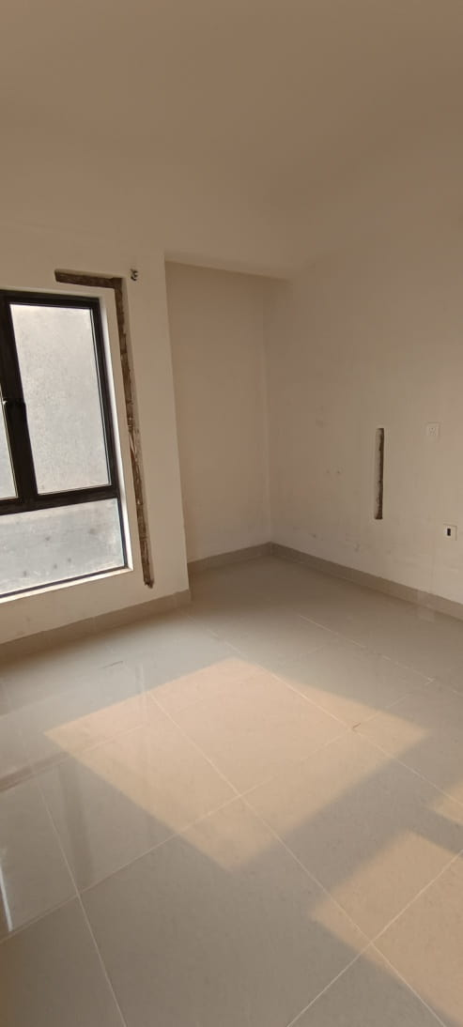
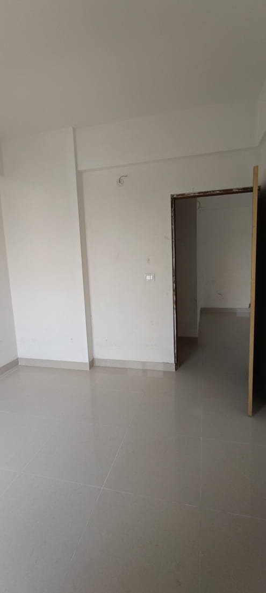
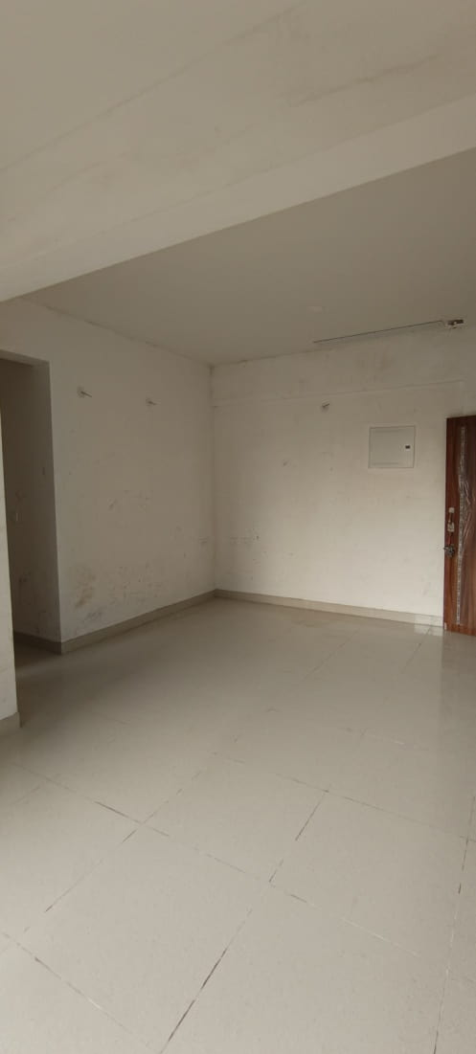
TOWER 1-2ND FLOOR STRUCTURAL WORKS COMPLETED, FINISHES IN PROGRESS
2ND FLOOR FLAT F – FLOORING, PUTTY, DOOR FRAME FIXING WORK COMPLETED
2ND FLOOR FLAT A -- FLOORING, PUTTY, DOOR FRAME FIXING WORK COMPLETED
2ND FLOOR FLAT C -- FLOORING, PUTTY, DOOR FRAME FIXING WORK COMPLETED

Slide 4
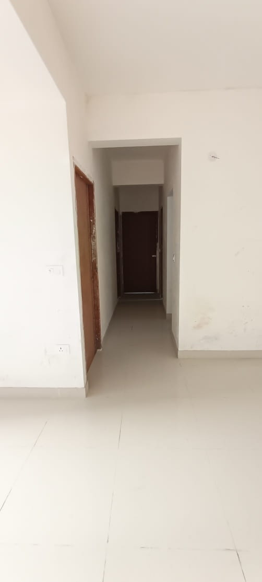
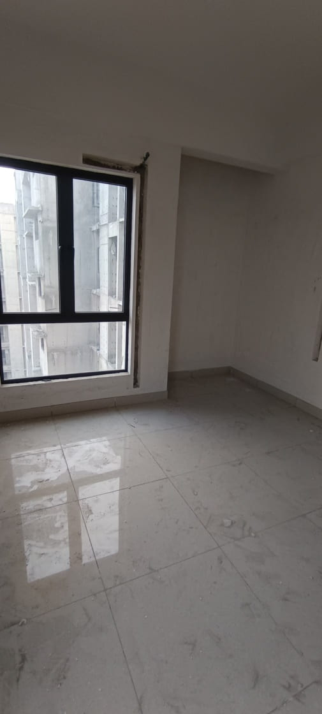
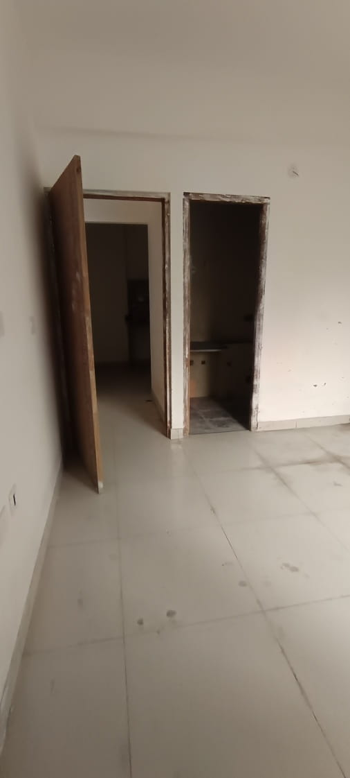
TOWER 1- 3RD FLOOR STRUCTURAL WORKS COMPLETED, FINISHES IN PROGRESS
3RD FLOOR FLAT E – FLOORING, PUTTY, DOOR FRAME FIXING WORK COMPLETED
3RD FLOOR FLAT C – FLOORING, PUTTY, DOOR FRAME FIXING WORK COMPLETED
3RD FLOOR FLAT A – FLOORING, PUTTY, DOOR FRAME FIXING WORK COMPLETED

Slide 5
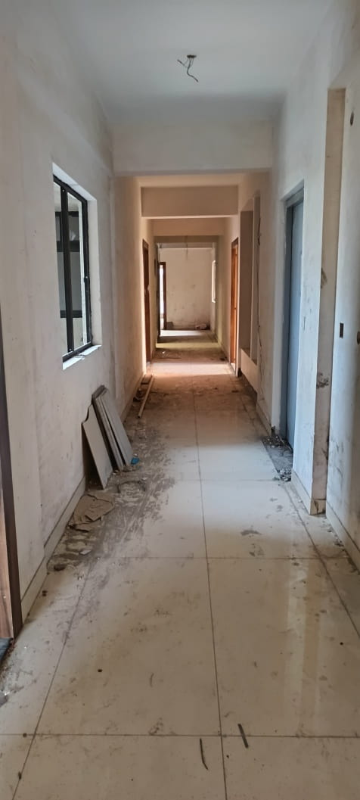
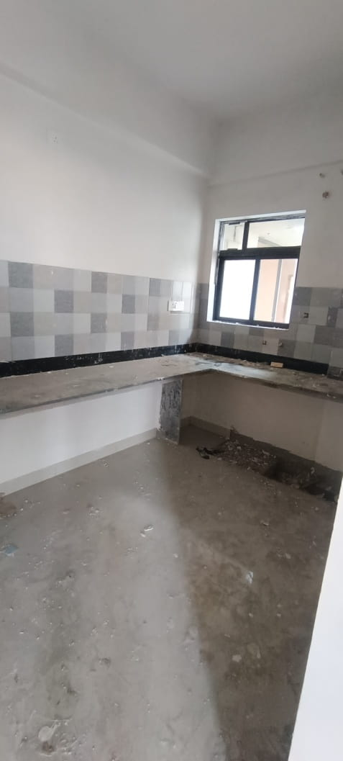
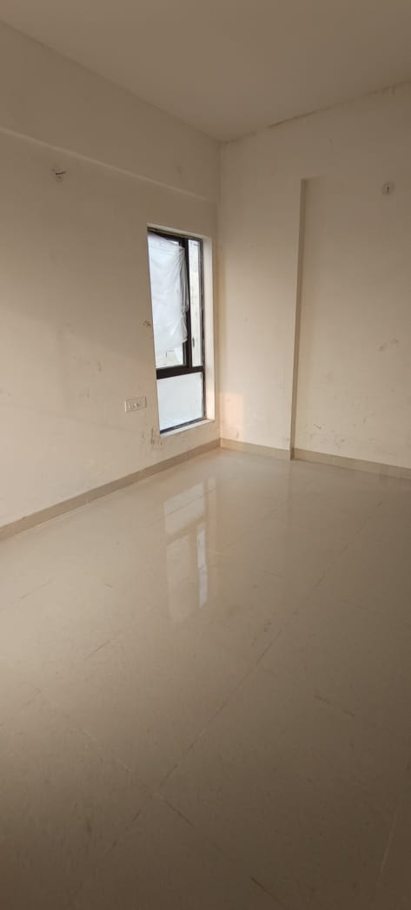
TOWER 1- 4TH FLOOR STRUCTURAL WORK COMPLETED, FINISHES IN PROGRESS
4TH FLOOR FLAT E – FLOORING, PUTTY, DOOR FRAME FIXING WORK COMPLETED
4TH FLOOR FLAT D – FLOORING, PUTTY, DOOR FRAME FIXING WORK COMPLETED
4TH FLOOR STRUCTURAL WORK COMPLETED

Slide 6
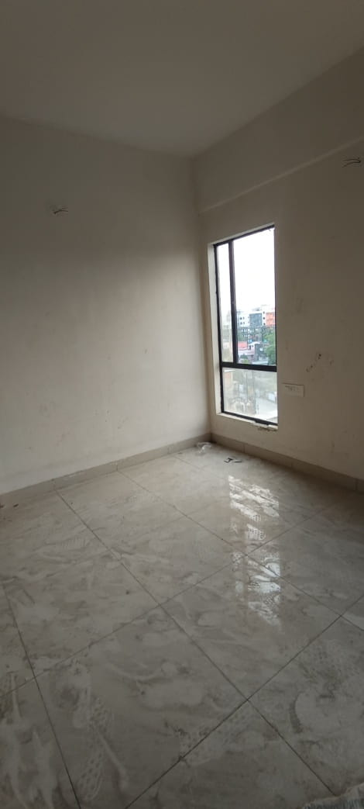
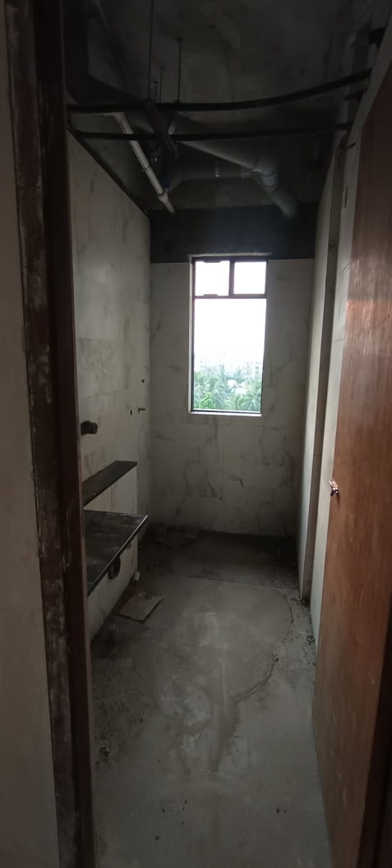
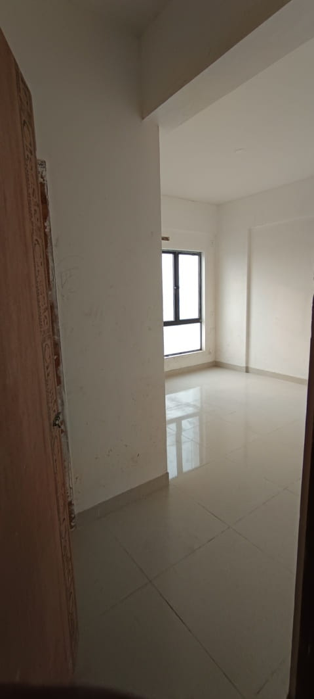
TOWER 1- 5 TH FLOOR STRUCTURAL WORK COMPLETED, FINISHES IN PROGRESS
5TH FLOOR FLAT D – FLOORING, PUTTY, DOOR FRAME FIXING WORK COMPLETED
5TH FLOOR FLAT B – FLOORING, PUTTY, DOOR FRAME FIXING WORK COMPLETED
5TH FLOOR FLAT E – FLOORING, PUTTY, DOOR FRAME FIXING WORK COMPLETED

Slide 7
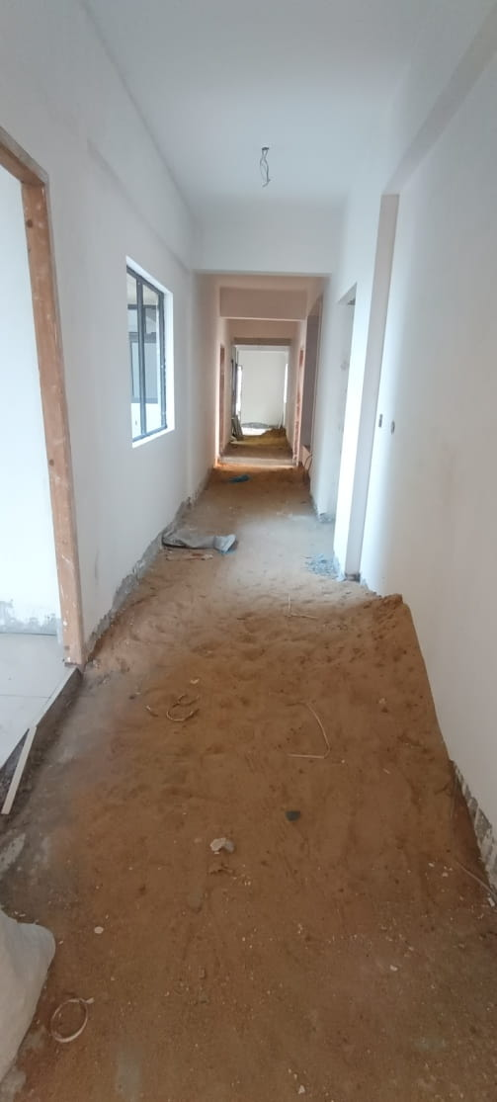
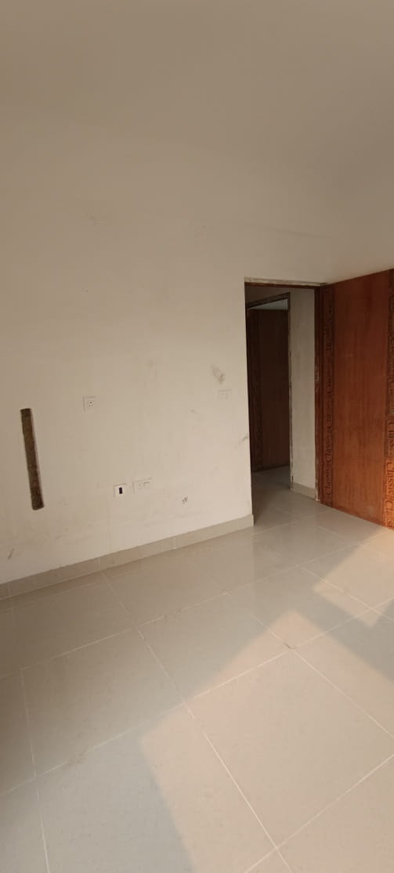
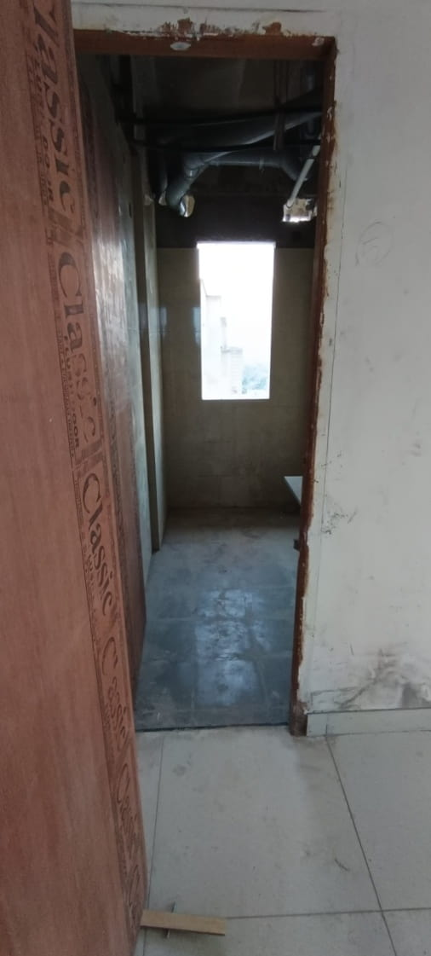
TOWER 1- 6TH FLOOR STRUCTURAL WORK COMPLETED, FINISHES IN PROGRESS
6TH FLOOR STRUCTURAL WORK COMPLETED
6TH FLOOR FLAT A – FLOORING, PUTTY, DOOR FRAME FIXING WORK COMPLETED
6TH FLOOR FLAT C – FLOORING, PUTTY, DOOR FRAME FIXING WORK COMPLETED

Slide 8
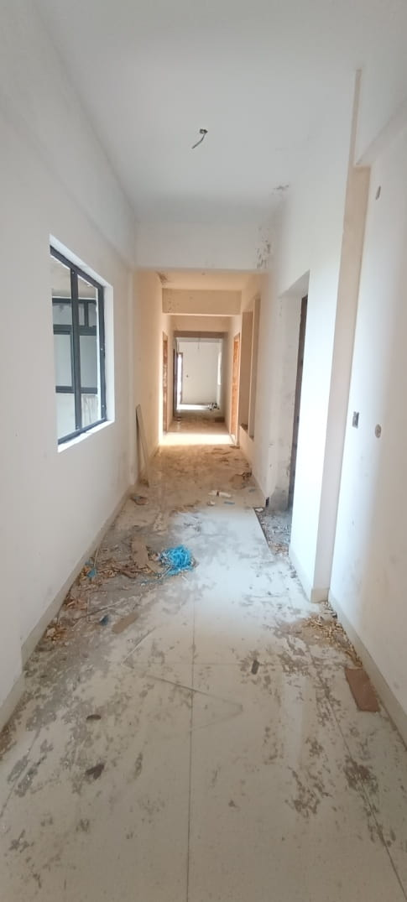
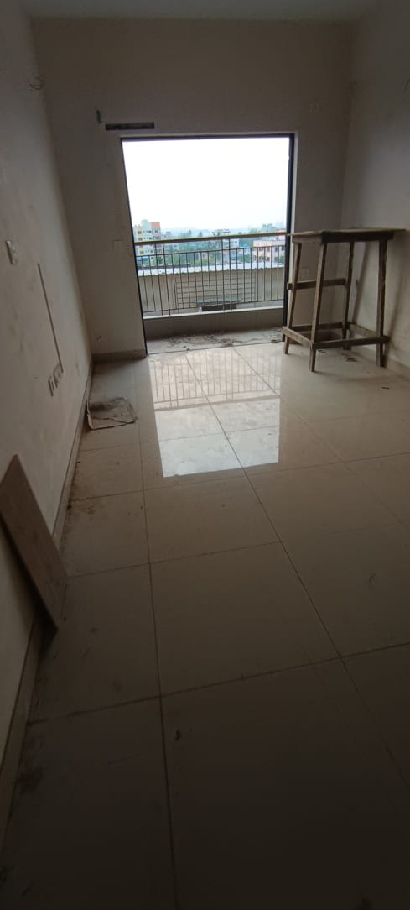
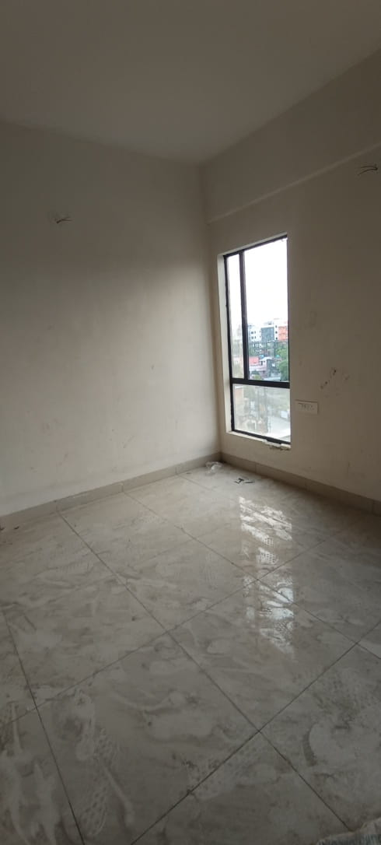
TOWER 1- 7TH FLOOR STRUCTURAL WORK COMPLETED, FINISHES IN PROGRESS
7TH FLOOR STRUCTURAL WORK COMPLETED
7TH FLOOR FLAT A – FLOORING, PUTTY, DOOR FRAME FIXING WORK COMPLETED
7TH FLOOR FLAT A – FLOORING, PUTTY, DOOR FRAME FIXING WORK COMPLETED

Slide 9
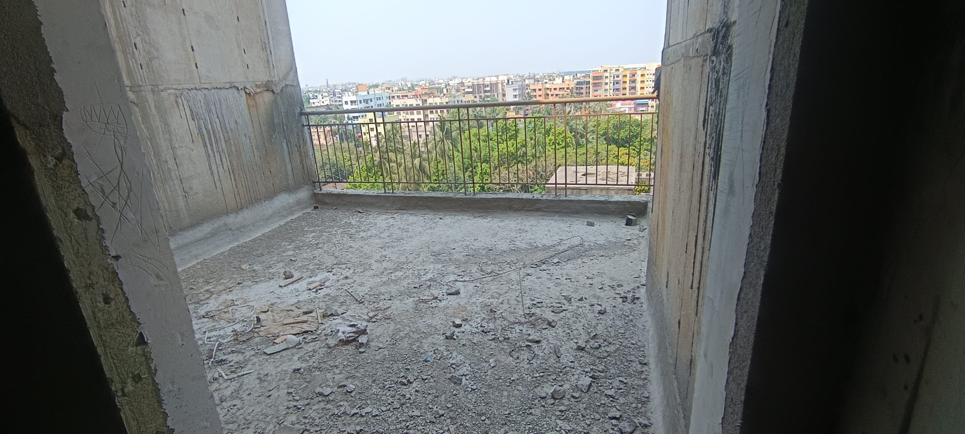
TOWER 1- FIRE SLAB STRUCTURAL WORKS COMPLETED

Slide 10
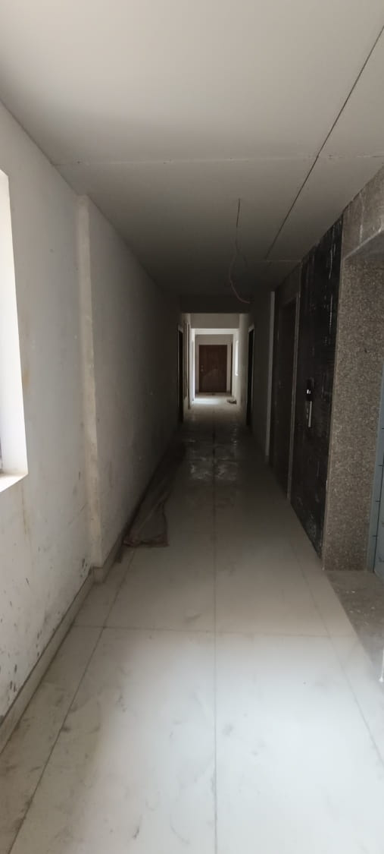
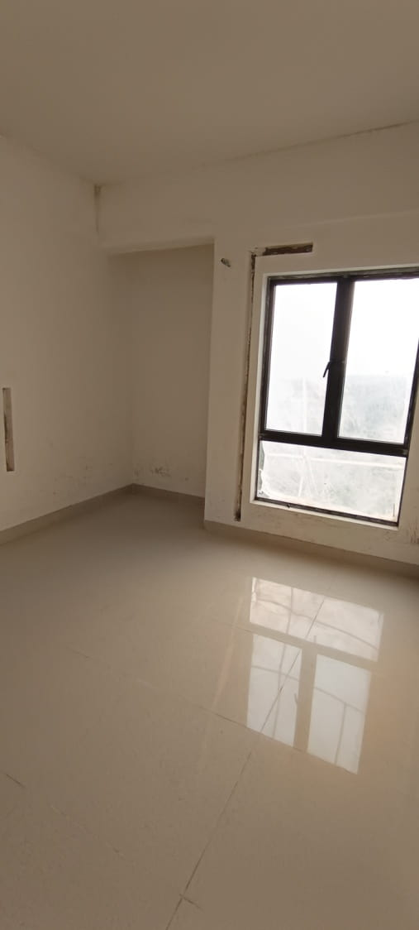
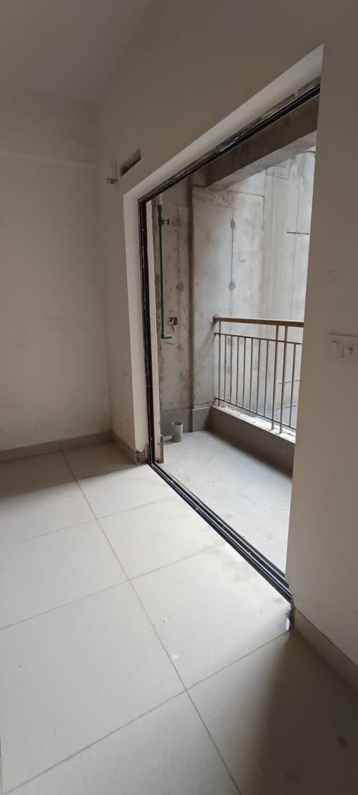
TOWER 1- 8TH FLOOR STRUCTURAL WORK COMPLETED, FINISHES IN PROGRESS
8TH FLOOR STRUCTURAL WORK COMPLETED
8TH FLOOR FLAT B – FLOORING, PUTTY, DOOR FRAME FIXING WORK COMPLETED
8TH FLOOR FLAT F – FLOORING, PUTTY, DOOR FRAME FIXING WORK COMPLETED

Slide 11
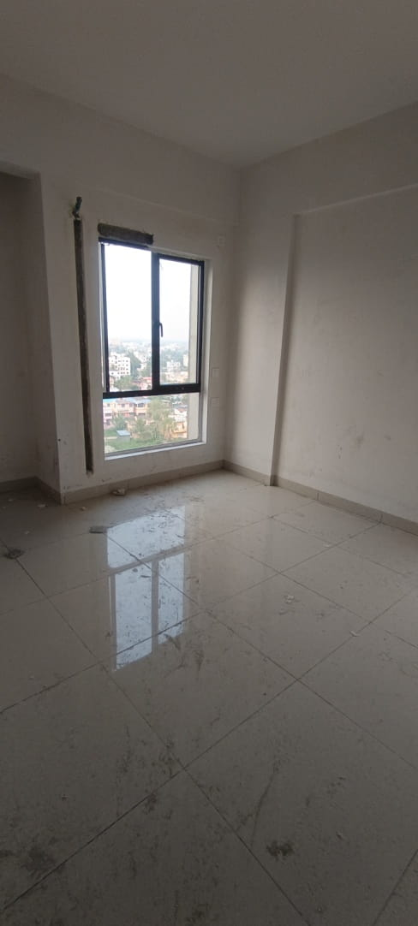

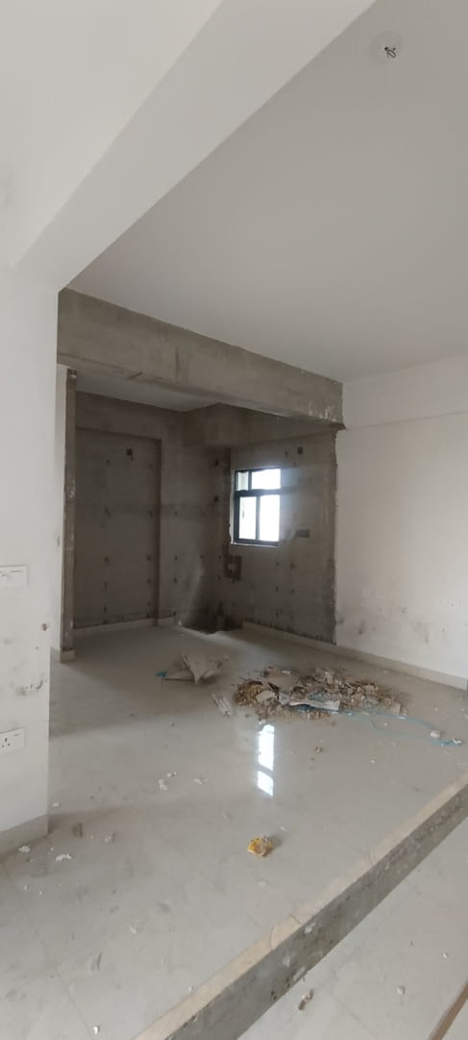
TOWER 1- 9TH FLOOR STRUCTURAL WORK COMPLETED, FINISHES IN PROGRESS
9TH FLOOR FLAT-E FLOORING, PUTTY, DOOR FRAME FIXING WORK COMPLETED
9TH FLOOR FLAT F – FLOORING, PUTTY, DOOR FRAME FIXING WORK COMPLETED
9TH FLOOR FLAT B – FLOORING, PUTTY, DOOR FRAME FIXING WORK COMPLETED

Slide 12

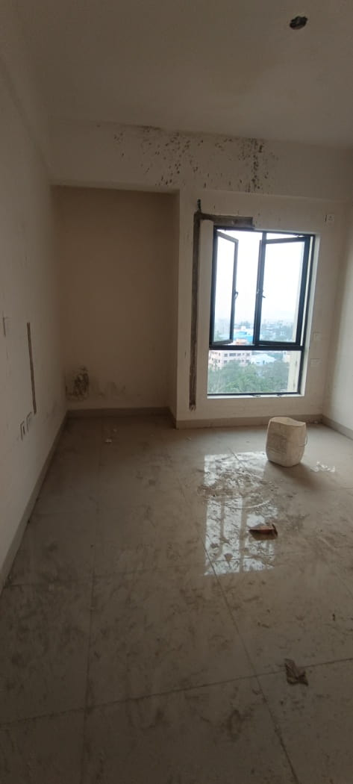

TOWER 1- 10TH FLOOR STRUCTURAL WORK COMPLETED, FINISHES IN PROGRESS
10TH FLOOR FLAT-F FLOORING, PUTTY, DOOR FRAME FIXING WORK COMPLETED
10TH FLOOR FLAT D – FLOORING, PUTTY, DOOR FRAME FIXING WORK COMPLETED
10TH FLOOR FLAT E –FLOORING, PUTTY, DOOR FRAME FIXING WORK COMPLETED

Slide 13
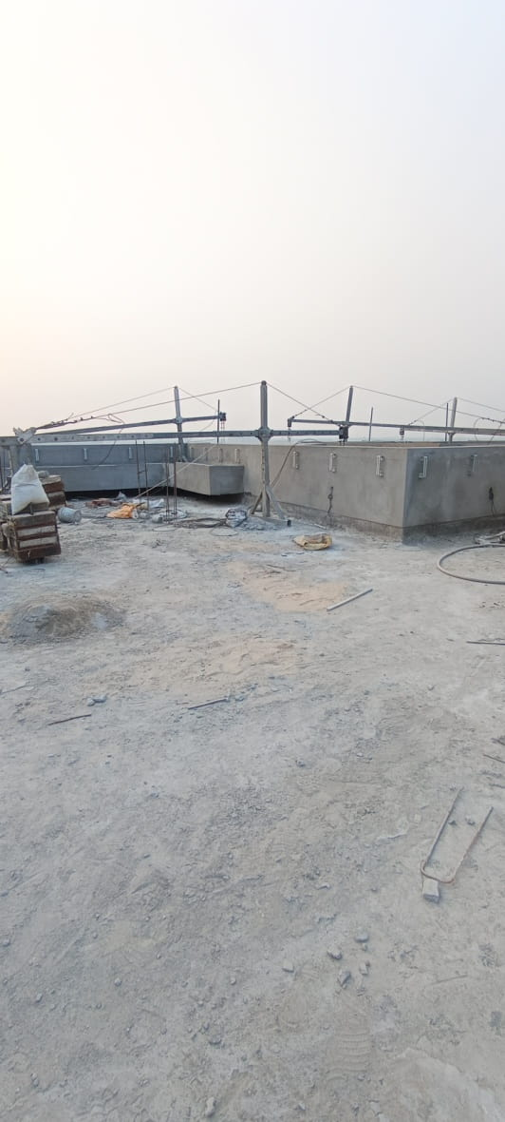
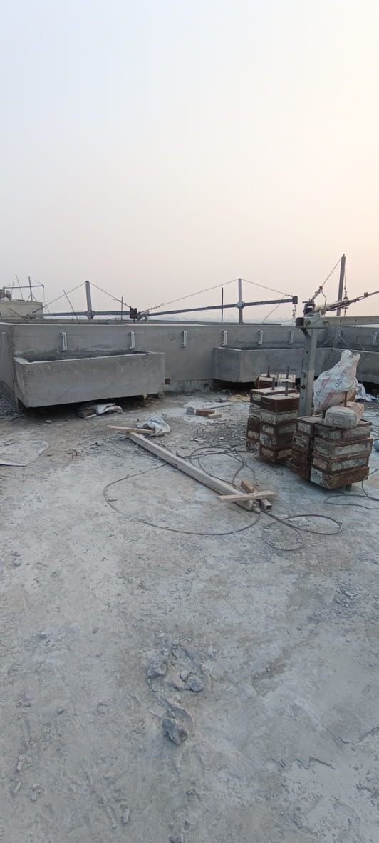
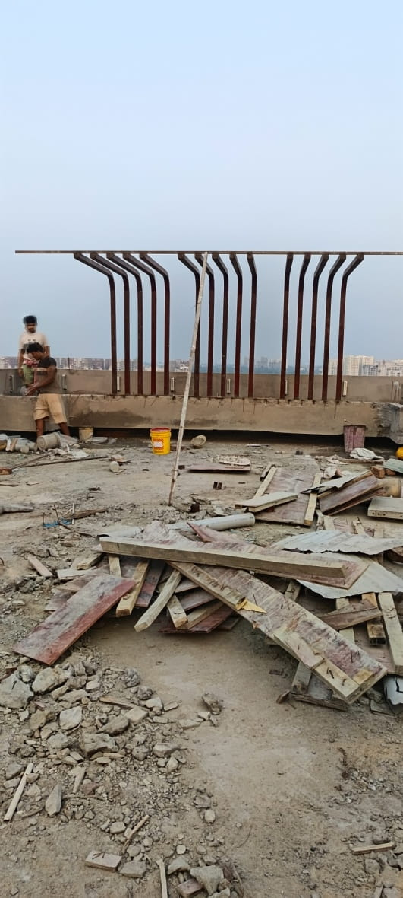
TOWER 1- ABOVE ROOF PLANTER & SITTING AREA STRUCTURAL, PLUMBING & FINISHING WORK IN PROGRESS

Slide 14
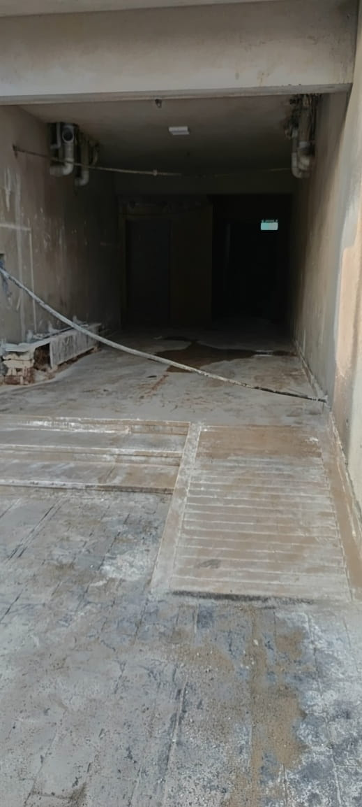
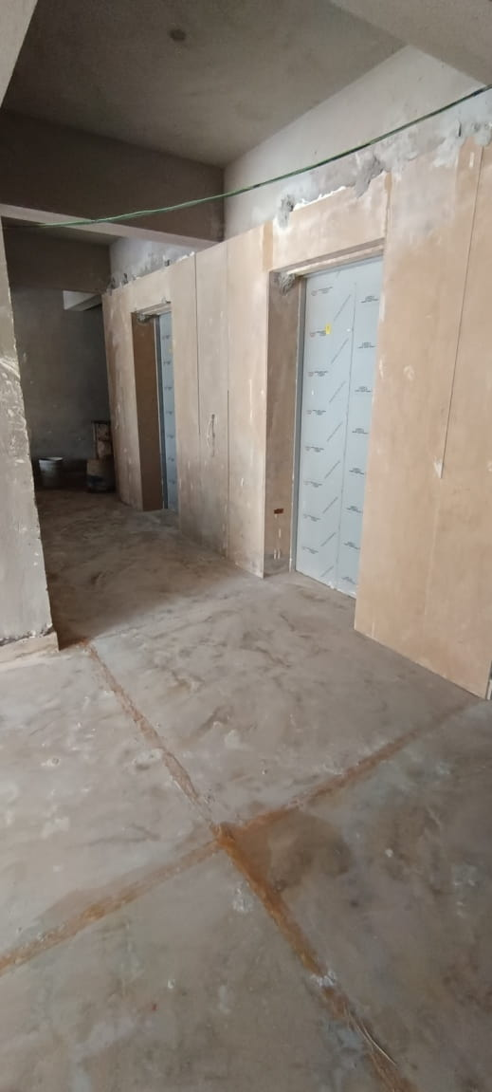
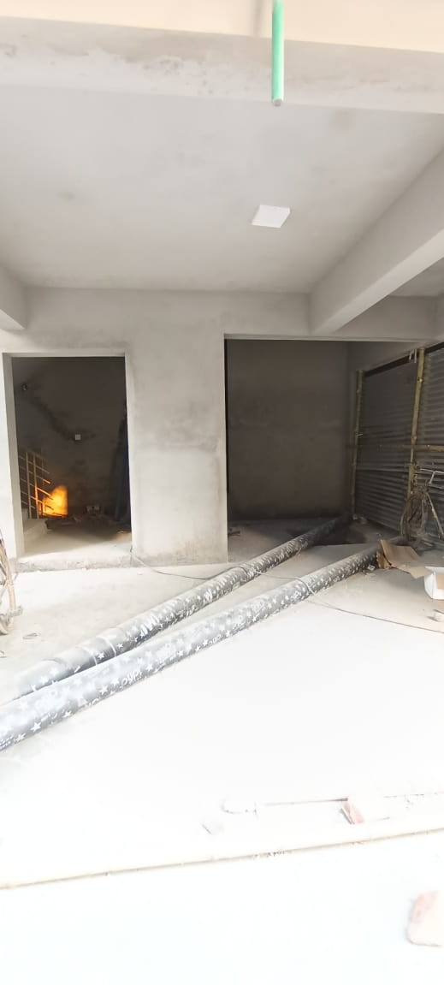
TOWER 2- GROUND FLOOR PLASTERING WORK PARTIALLY COMPLETED, FLOORING WORK IN PROGRESS

Slide 15
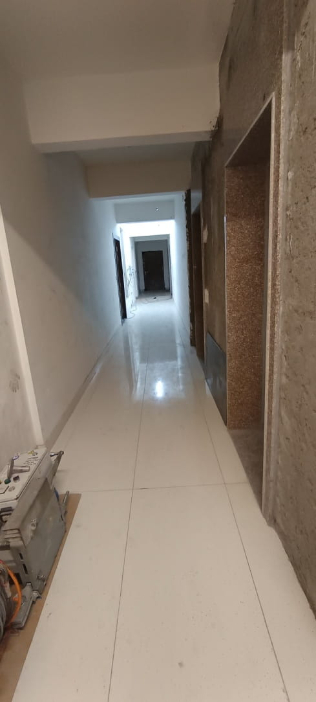
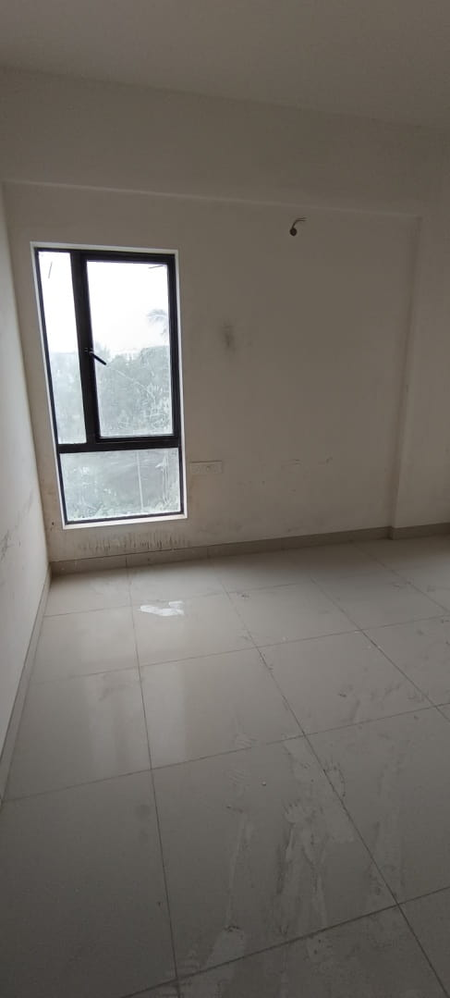
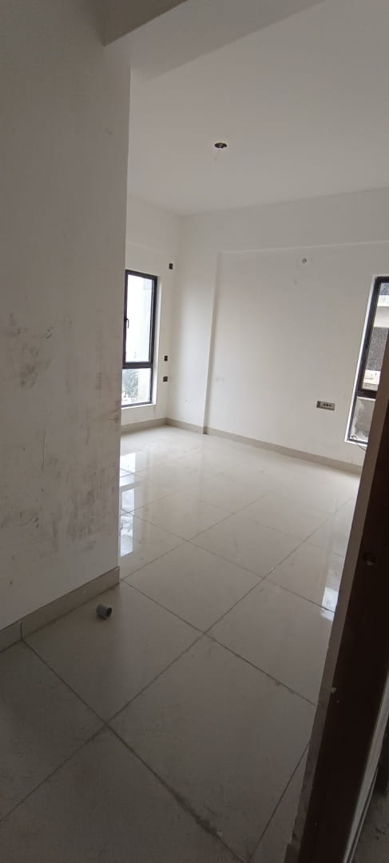
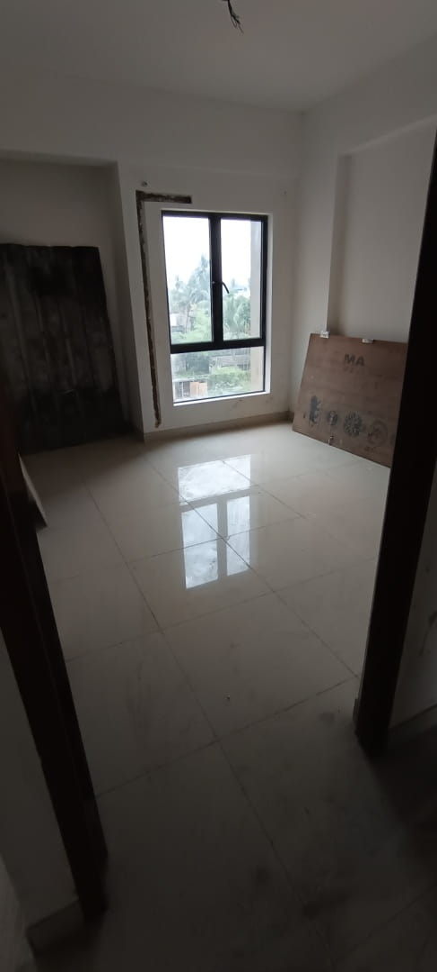
TOWER 2- 1ST FLOOR STRUCTURAL WORKS COMPLETED, FINISHES IN PROGRESS
1ST FLOOR LOBBY STRUCTURAL WORK COMPLETED, FINISHING IN PROGRESS
1ST FLOOR FLAT D – FLOORING, PUTTY, DOOR & WINDOW FRAME FIXING WORK COMPLETED
1ST FLOOR FLAT E – FLOORING, PUTTY, DOOR & WINDOW FRAME FIXING WORK COMPLETED
1ST FLOOR FLAT F– FLOORING, PUTTY, DOOR & WINDOW FRAME FIXING WORK COMPLETED

Slide 16
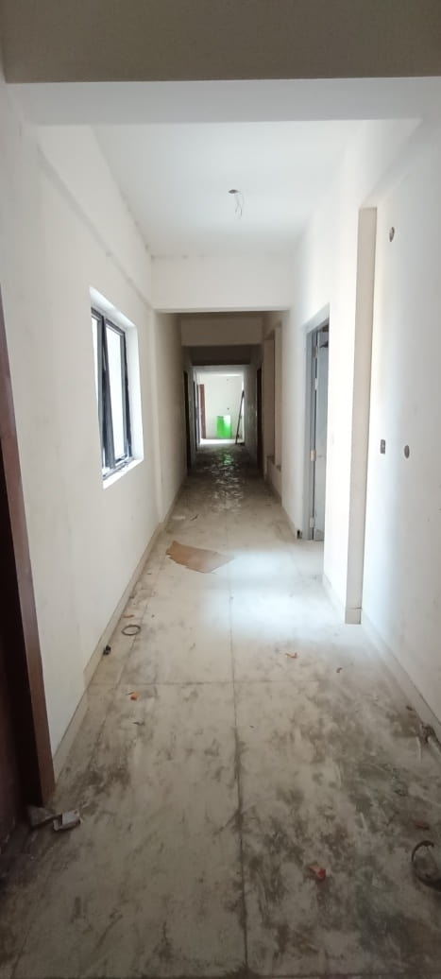
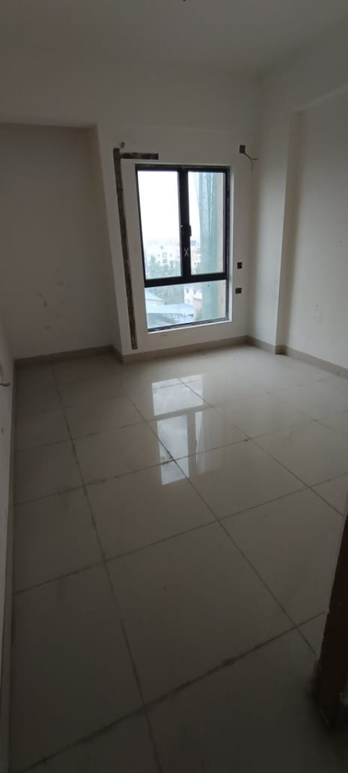
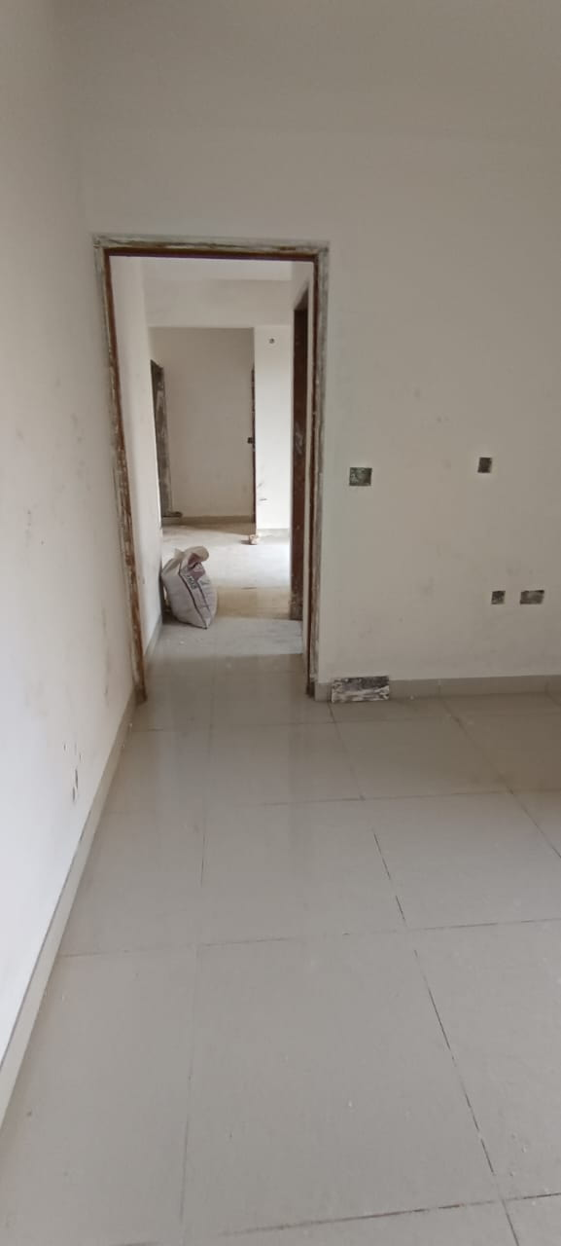
TOWER 2- 2ND FLOOR STRUCTURAL WORKS COMPLETED, FINISHES IN PROGRESS
2ND FLOOR LOBBY STRUCTURAL WORK COMPLETED, FINISHING IN PROGRESS
2ND FLOOR FLAT A – FLOORING, PUTTY, DOOR & WINDOW FRAME FIXING WORK COMPLETED
2ND FLOOR FLAT E – FLOORING, PUTTY, DOOR & WINDOW FRAME FIXING WORK COMPLETED

Slide 17
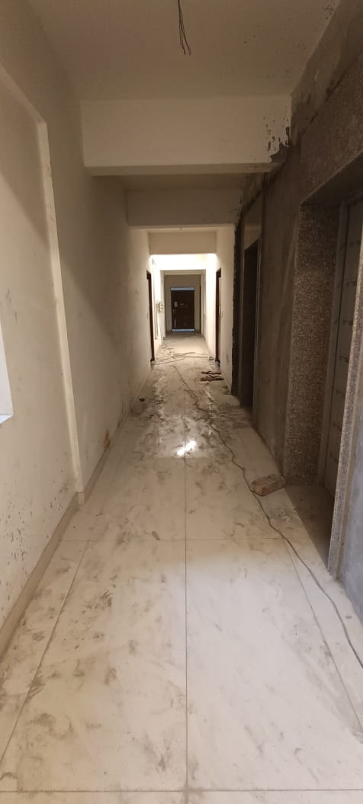

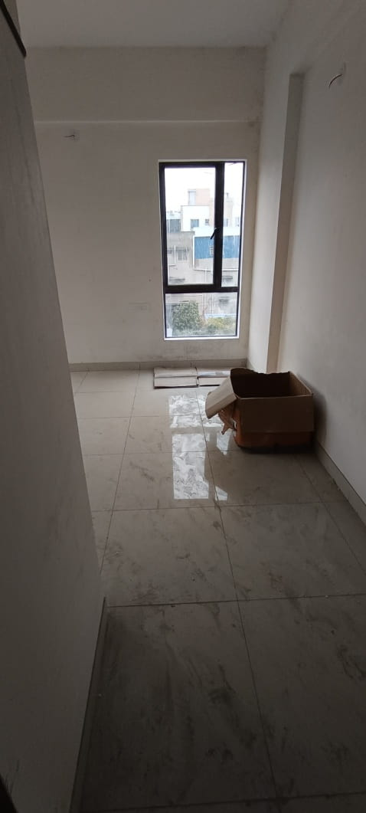
TOWER 2- 3RD FLOOR STRUCTURAL WORKS COMPLETED, FINISHES IN PROGRESS
3RD FLOOR LOBBY STRUCTURAL WORK COMPLETED, FINISHING IN PROGRESS
3RD FLOOR FLAT A – FLOORING, PUTTY, DOOR & WINDOW FRAME FIXING WORK COMPLETED
3RD FLOOR FLAT E – FLOORING, PUTTY, DOOR & WINDOW FRAME FIXING WORK COMPLETED

Slide 18

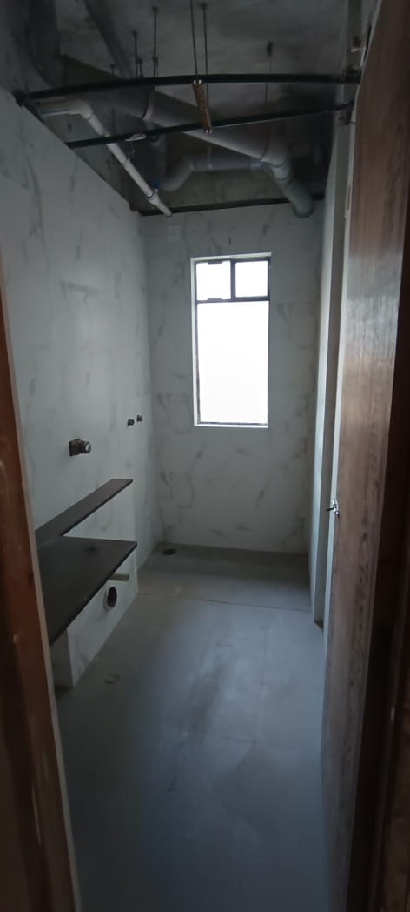
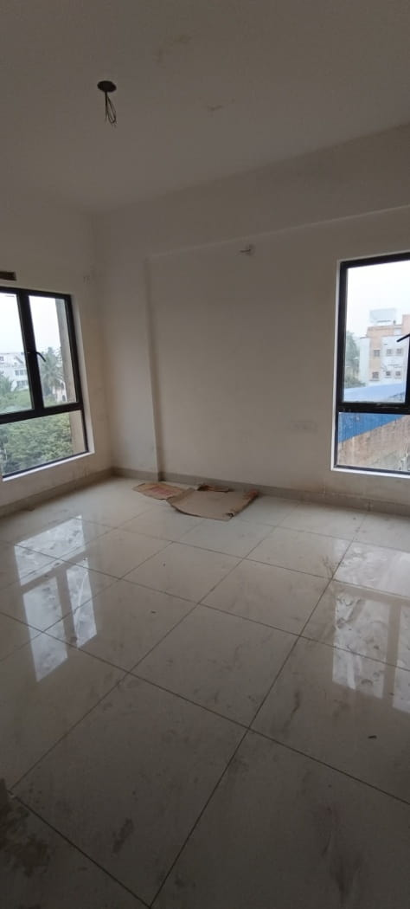
TOWER 2- 4TH FLOOR STRUCTURAL WORKS COMPLETED, FINISHES IN PROGRESS
4TH FLOOR FLAT C – FLOORING, PUTTY, DOOR & WINDOW FRAME FIXING WORK COMPLETED
4TH FLOOR FLAT A – FLOORING, PUTTY, DOOR & WINDOW FRAME FIXING WORK COMPLETED
4TH FLOOR FLAT D – FLOORING, PUTTY, DOOR & WINDOW FRAME FIXING WORK COMPLETED

Slide 19
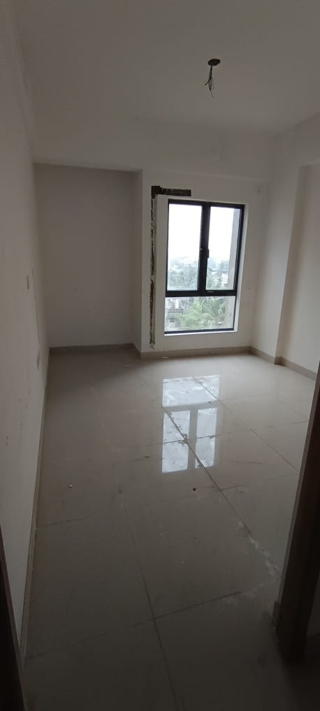
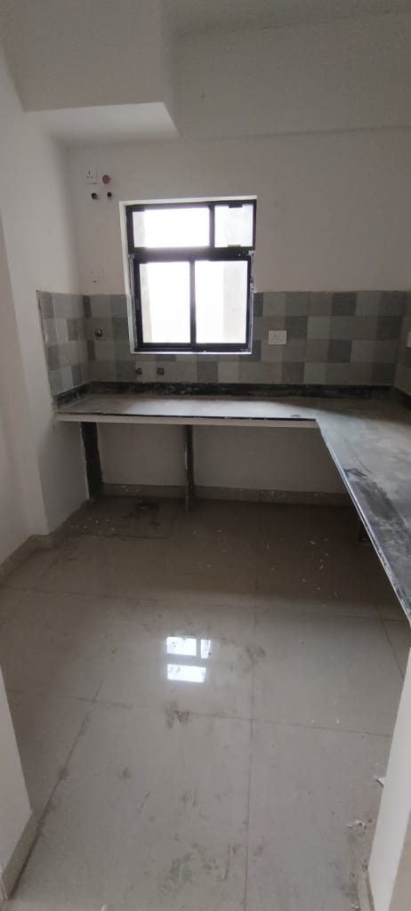

TOWER 2- 5TH FLOOR STRUCTURAL WORKS COMPLETED, FINISHES IN PROGRESS
5TH FLOOR FLAT-F FLOORING, PUTTY, DOOR & WINDOW FRAME FIXING WORK COMPLETED
5TH FLOOR FLAT-E FLOORING, PUTTY, DOOR & WINDOW FRAME FIXING WORK COMPLETED
5TH FLOOR FLAT-A FLOORING, PUTTY, DOOR & WINDOW FRAME FIXING WORK COMPLETED

Slide 20



TOWER 2- 6TH FLOOR STRUCTURAL WORK COMPLETED, FINISHES IN PROGRESS
6TH FLOOR STRUCTURAL WORK COMPLETED, FINISHING IN PROGRESS
6TH FLOOR FLAT-D FLOORING, PUTTY, DOOR & WINDOW FRAME FIXING WORK COMPLETED
6TH FLOOR FLAT-C FLOORING, PUTTY, DOOR & WINDOW FRAME FIXING WORK COMPLETED

Slide 21



TOWER 2- 7TH FLOOR STRUCTURAL WORK COMPLETED. FINISHES IN PROGRESS
7TH FLOOR STRUCTURAL WORK COMPLETED, FINISHING IN PROGRESS
7TH FLOOR FLAT-E FLOORING, PUTTY, DOOR & WINDOW FRAME FIXING WORK COMPLETED
7TH FLOOR FLAT-A FLOORING, PUTTY, DOOR & WINDOW FRAME FIXING WORK COMPLETED

Slide 22

TOWER 2- FIRE SLAB STRUCTURAL WORK COMPLETED

Slide 23



TOWER 2- 8TH FLOOR STRUCTURAL WORK COMPLETED, FINISHES IN PROGRESS.
8TH FLOOR FLAT-A FLOORING, PUTTY, DOOR & WINDOW FRAME FIXING WORK COMPLETED
8TH FLOOR FLAT-B FLOORING, PUTTY, DOOR & WINDOW FRAME FIXING WORK COMPLETED
8TH FLOOR FLAT-F FLOORING, PUTTY, DOOR & WINDOW FRAME FIXING WORK COMPLETED

Slide 24



TOWER 2- 9TH FLOOR STRUCTURAL WORK COMPLETED, FINISHES IN PROGRESS.
9TH FLOOR FLAT-C FLOORING, PUTTY, DOOR & WINDOW FRAME FIXING WORK COMPLETED
9TH FLOOR FLAT-A FLOORING, PUTTY, DOOR & WINDOW FRAME FIXING WORK COMPLETED
9TH FLOOR FLAT-E FLOORING, PUTTY, DOOR & WINDOW FRAME FIXING WORK COMPLETED

Slide 25



TOWER 2- 10TH FLOOR STRUCTURAL WORK COMPLETED, FINISHES IN PROGRESS.
10TH FLOOR STRUCTURAL WORK COMPLETED, FINISHING IN PROGRESS
10TH FLOOR FLAT-C FLOORING, PUTTY, DOOR & WINDOW FRAME FIXING WORK COMPLETED
10TH FLOOR FLAT-C FLOORING, PUTTY, DOOR & WINDOW FRAME FIXING WORK COMPLETED

Slide 26



TOWER 2- ABOVE ROOF PLANTER & SITTING AREA STRUCTURAL, PLUMBING & FINISHING WORK IN PROGRESS

Slide 27

PODIUM & CLUB - CLUB AT 1ST FLOOR & SWIMMING POOL STRUCTURAL WORK COMPLETED, WATERPROOFING WORK IN PROGRESS

